Slide 1
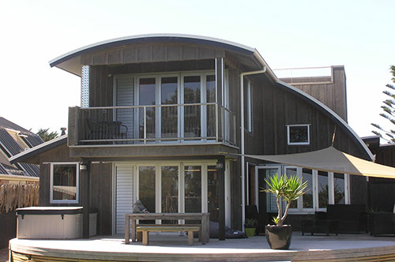
Computing Project
House rental system
By: Rupesh Dhakal

Slide 2
Introduction
House booking system is an application that enables to search great new deals on houses, flats and in other various properties. Properties can be searched from anywhere at any time.
Its is just not limited to booking of houses but other properties also.
Focuses on booking, renting property.

Slide 3
Background of the project
The main reason behind developing this project is to provide a facility to buy and sell property.
Best deals on property an be found
To guide towards best deals
Search that feel familiar
Built the ultimate resource for property solution with easy to understand tools.

Slide 4
Problem statement
This web application can address and solve or improve many issues regarding this particular field.
Reduces human effort and hustle
Realtime decision making
Reduces awkward situations
Some human find dealing in phone and text much easier.

Slide 5
Aims and objectives
Aims:
The overall goals of the project that needs to be fulfilled are:
Time and Efficiency
Flexibility
To make user friendly environment

Slide 6
Aims and objectives – 1
Make application run smoothly along with performing functionality of the application without any error.
Make user able to find reasonable deals.
Make property search easy and fast.

Slide 7
Aims and objectives – 1
Objectives:
The individual stage that leads to achieve those overall goals are:
Login and Sign-up facility
Details regarding the project will lead to make correct decision
Taking deep attention towards look, feel and usability of the project to make it user friendly.

Slide 8

Making program bug free which
Will make application more robust.

Slide 9
Feature of the project
This project main task is simpler but it contains many feature that will make user perform task easily and quickly.
User signup and login
Quick view of best property value
Can search property according to location
Contains admin user verification to post the property(security)
Privilege to become admin and earn money
Quick query

Slide 10
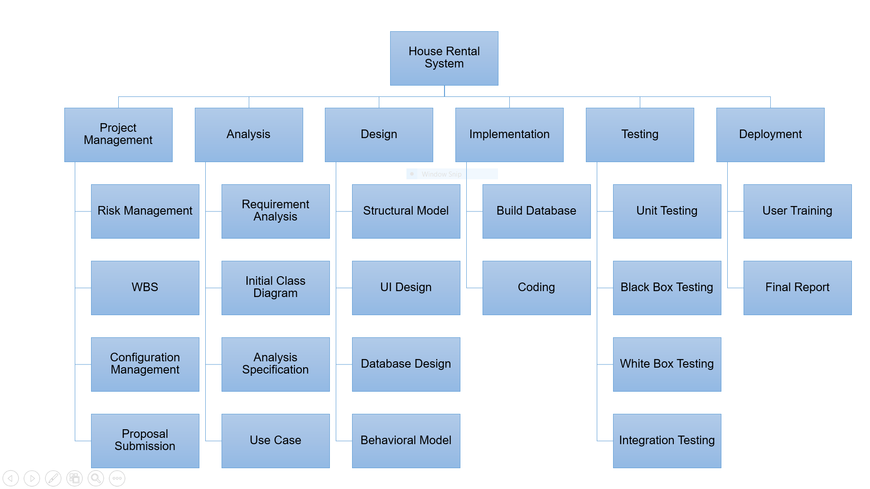
WBS(work breakdown structure)

Slide 11
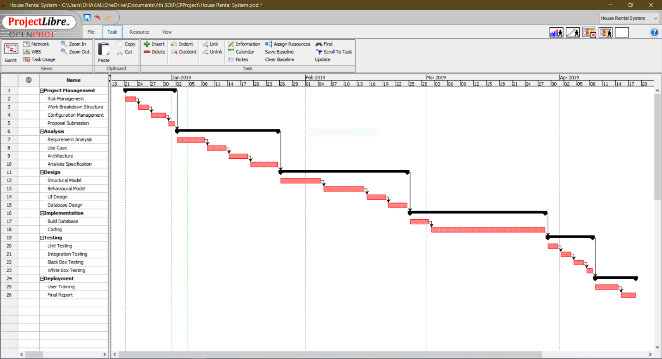
Gantt Chart

Slide 12
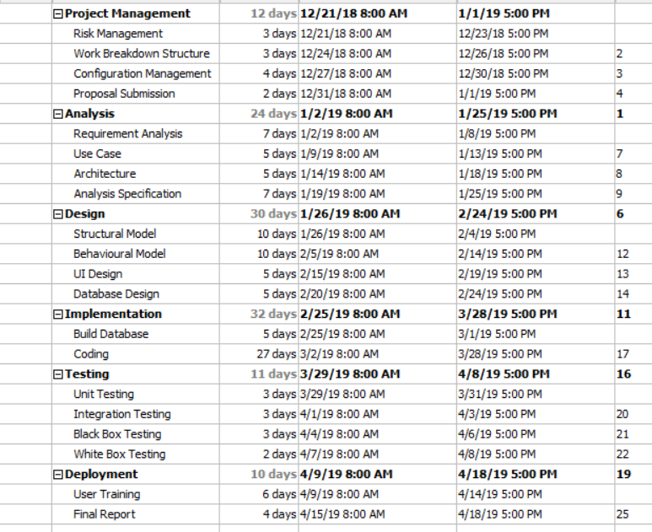
Gantt Chart - 1

Slide 13
Methodology
I have used waterfall development methodology to develop this project, It consists of following steps
Project management(Requirement)
Analysis
Design
Implementation
Testing
Maintenance

Slide 14
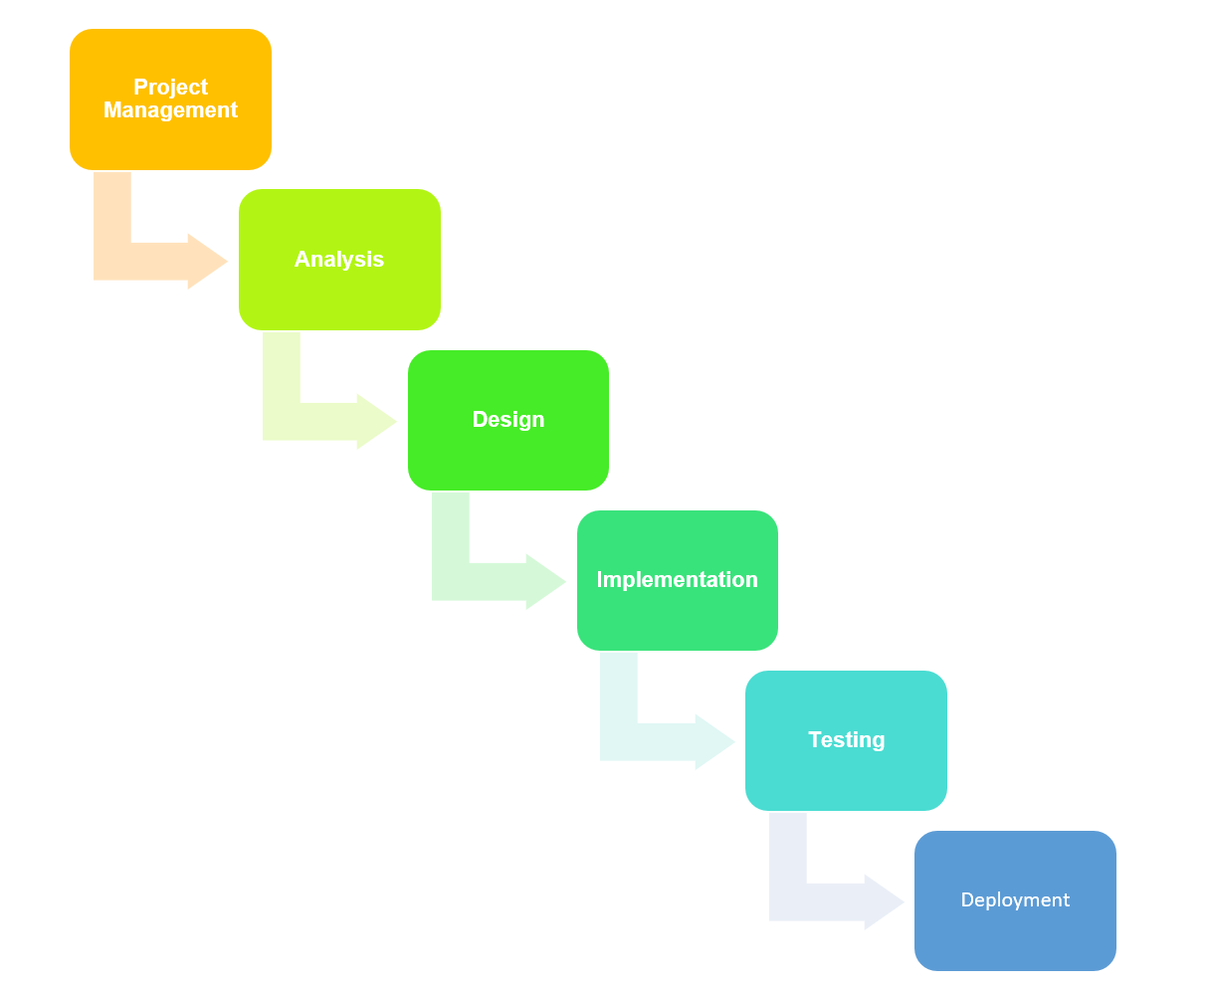
Methodology - 1

Slide 15
Methodology - 2
Reasons for using waterfall model as development methodology are:
Mainly it is easy to understand
Phases are completed one at a time hence process do not overlap
As it is not an iterative process we can ensure that the previous phase is completed before jumping on other phase.

Slide 16
Architecture
I have used 3-tier Architecture for developing my project.
3-tier architecture is a hierarchical software architecture which is divided into three layers:
A presentation layer
An application layer
A data layer

Slide 17
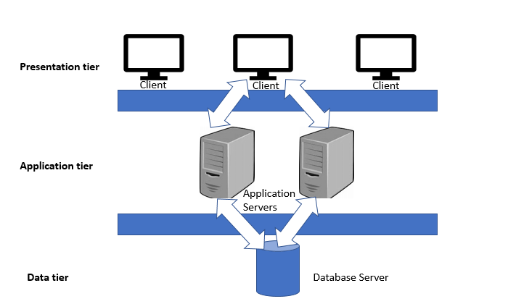
Architecture - 1

Slide 18
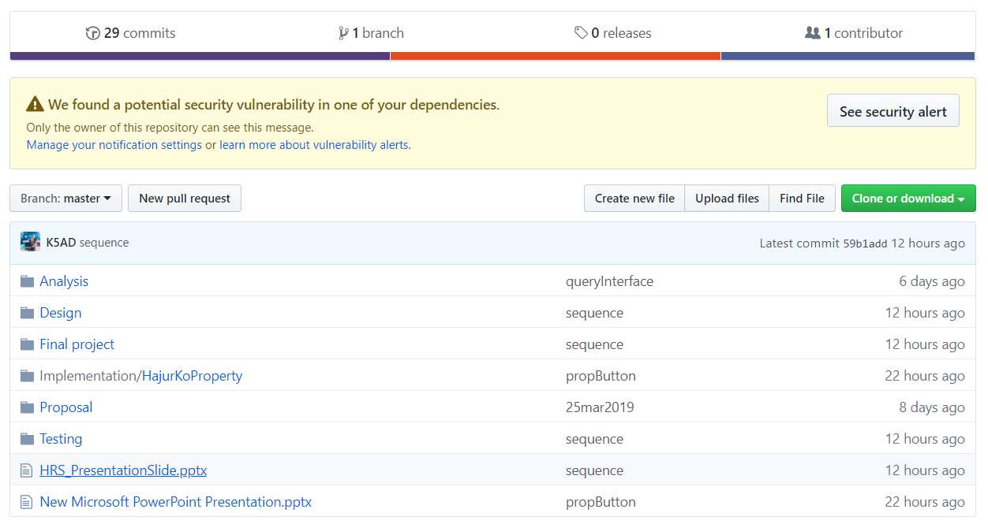
Risk and Configuration management
Configuration Management is the process of establishing and maintaining consistency of the product’s performance, functional and physical attributes with its requirements, design and operation information through its life (Rouse, 2019) .

Slide 19
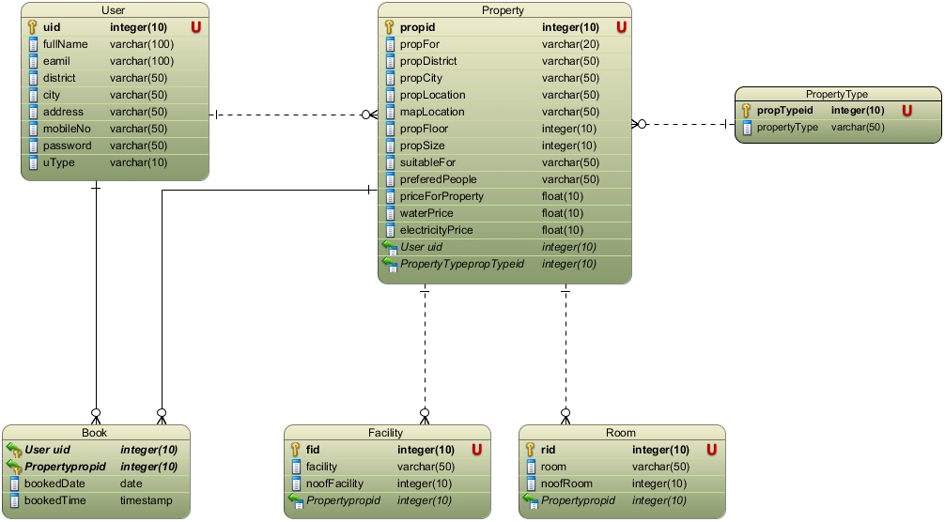
Design
ER-Diagram

Slide 20
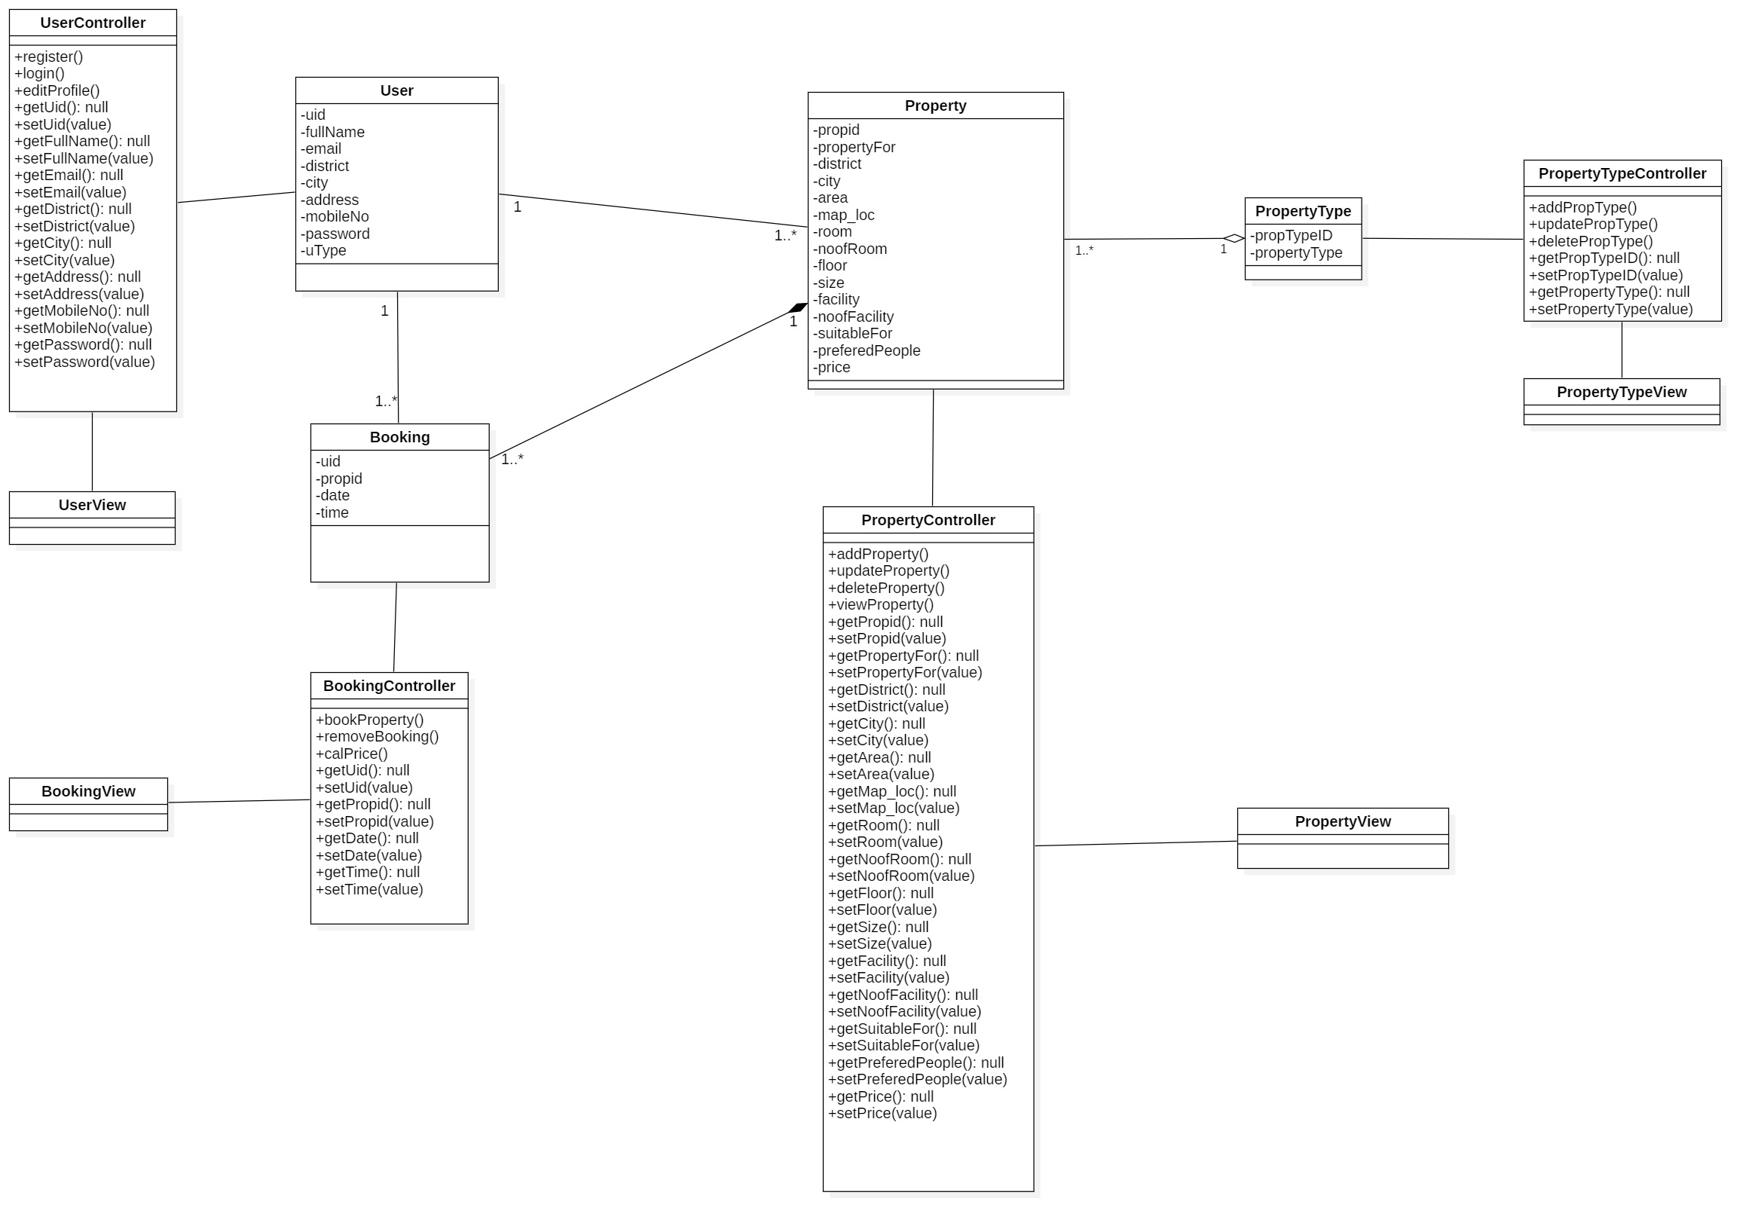
Static System Architecture

Slide 21
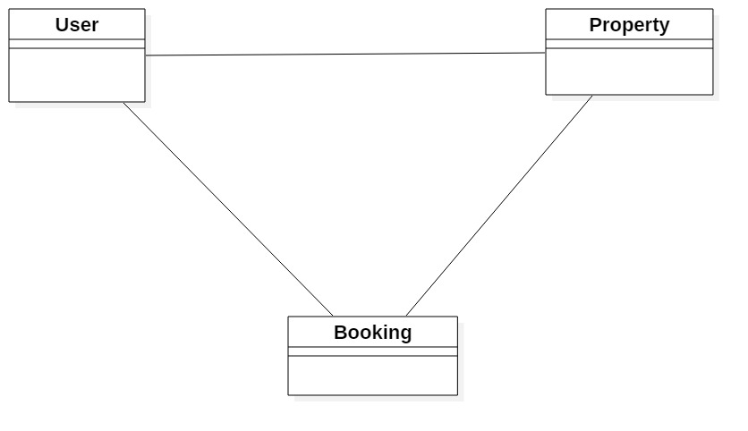
Initial class diagram

Slide 22
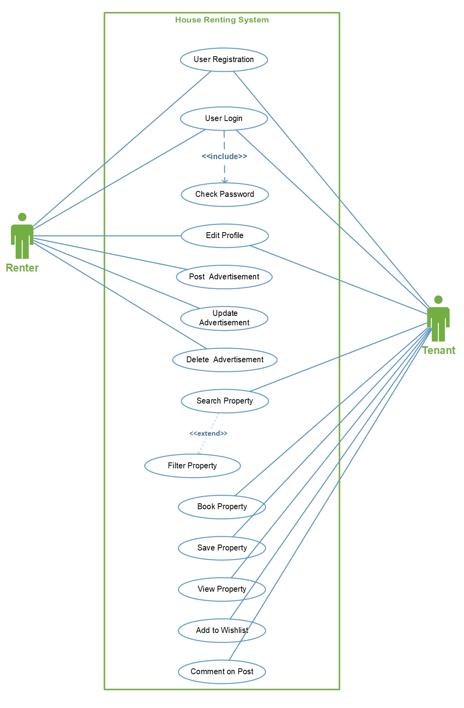
Use-Case Diagram

Slide 23
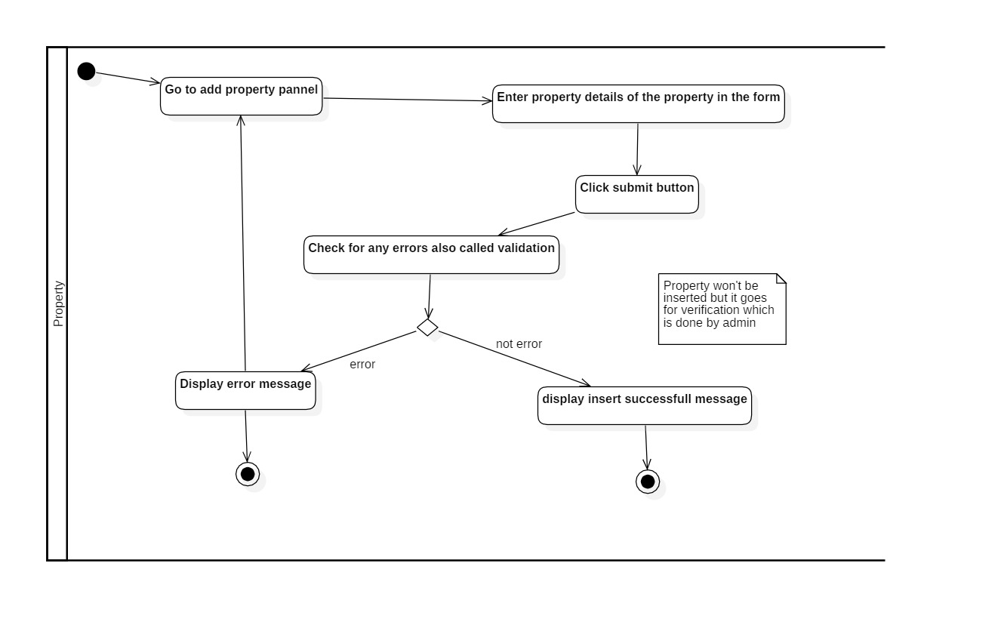
Activity Diagram – add property

Slide 24
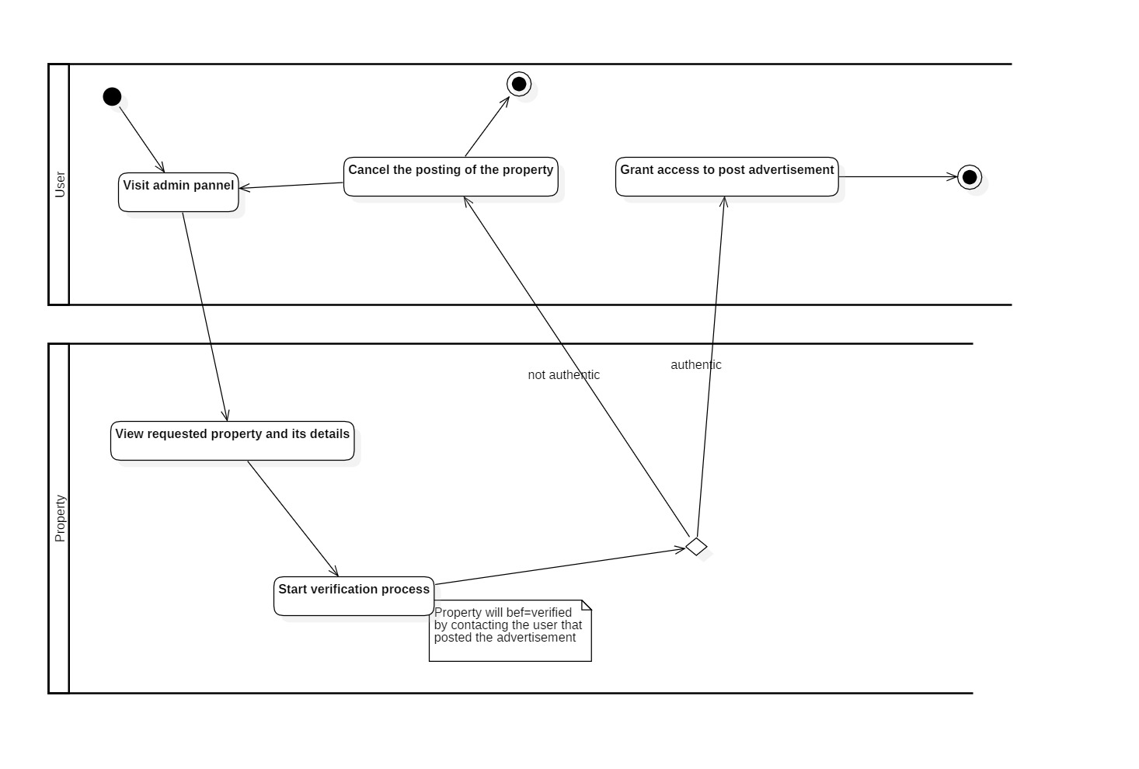
Activity Diagram – admin verification

Slide 25
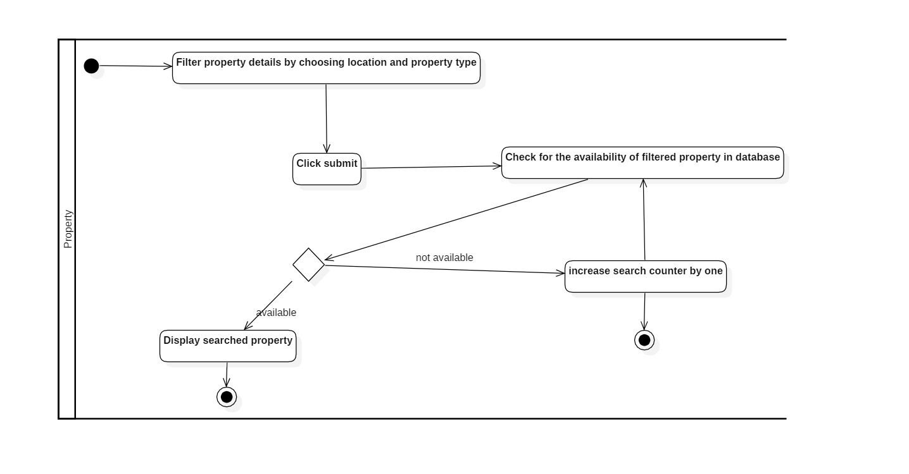
Activity Diagram – search property

Slide 26
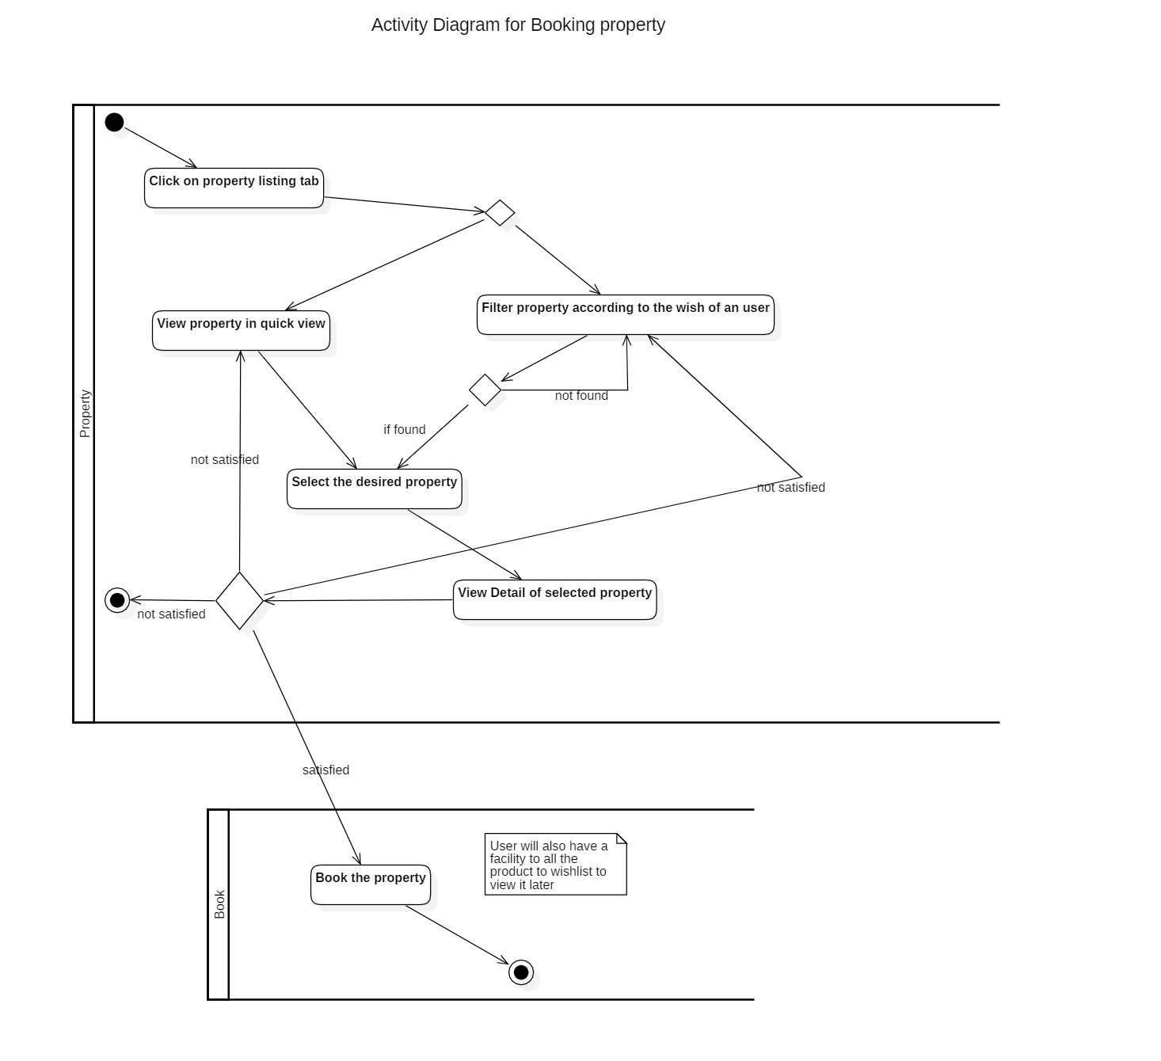
Activity Diagram – Book Property

Slide 27
Sequence Diagram

Slide 28
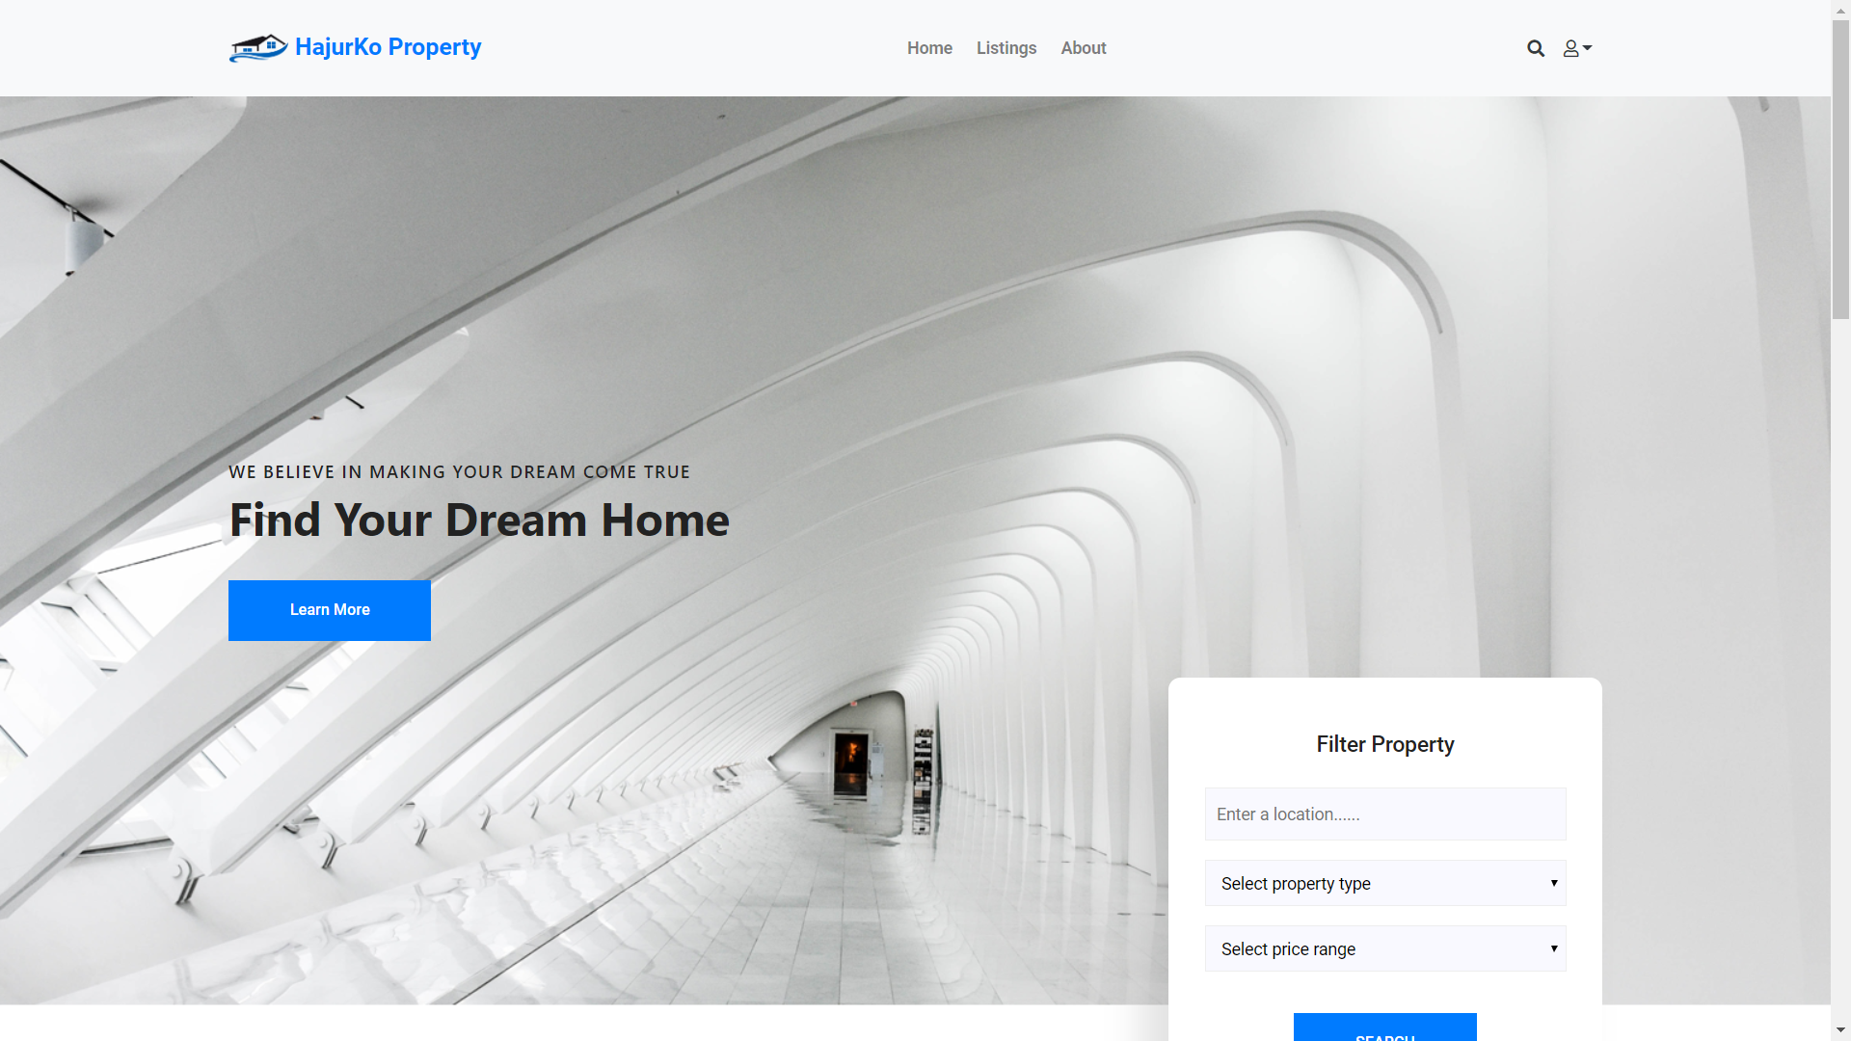
UI-Design : Home Page
Only some UI-Design are included

Slide 29
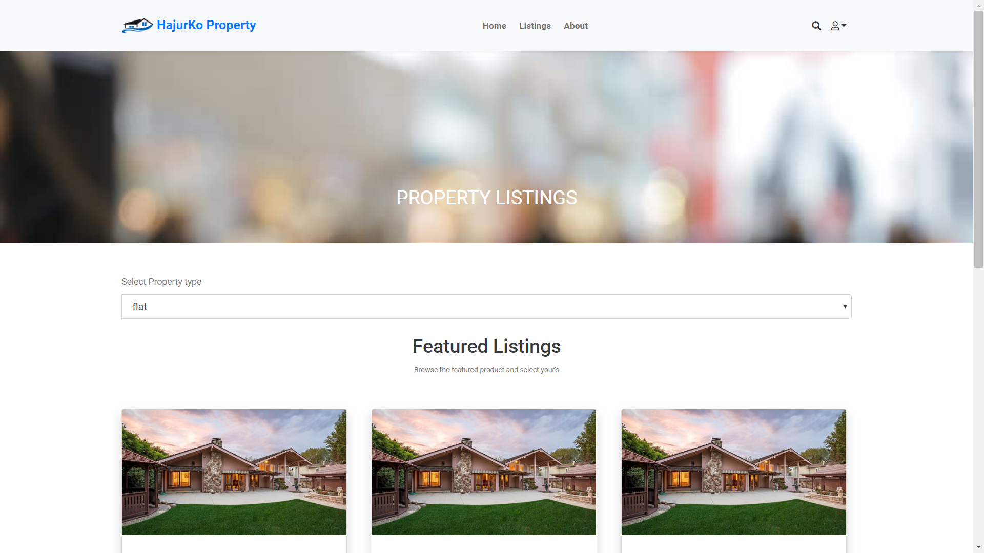
UI-Design : Property Listings

Slide 30
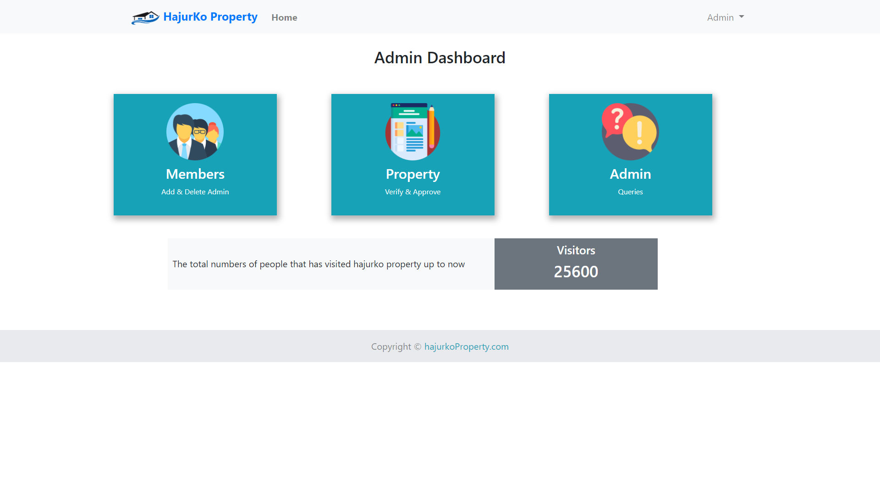
UI-Design : Admin Dashboard

Slide 31
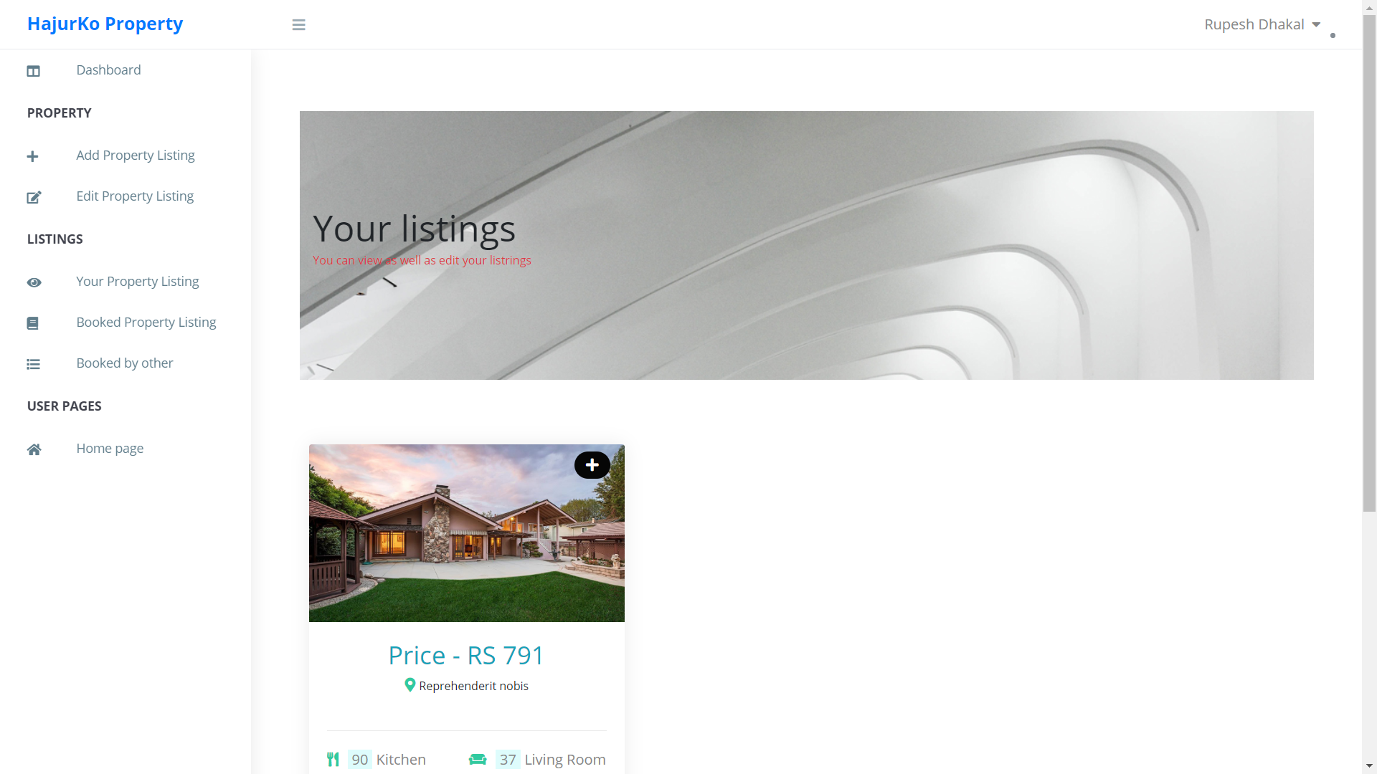
UI-Design : User Property Listing pannel

Slide 32
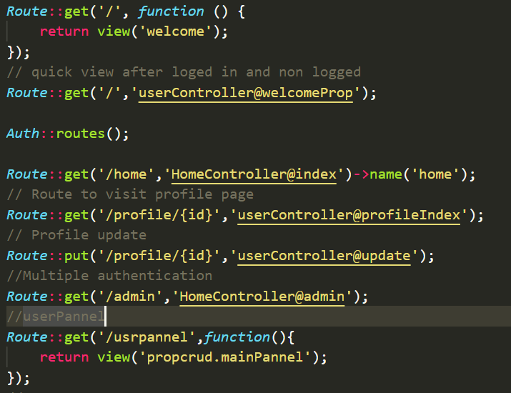
Coding - Routes
Only certain part of the coding is included

Slide 33
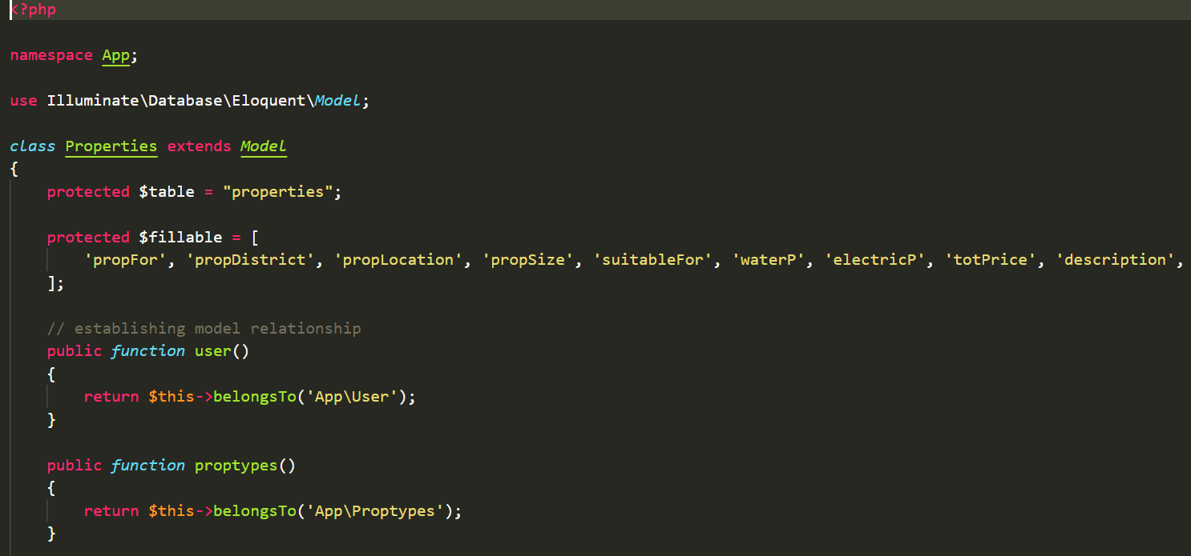
Coding - Model

Slide 34
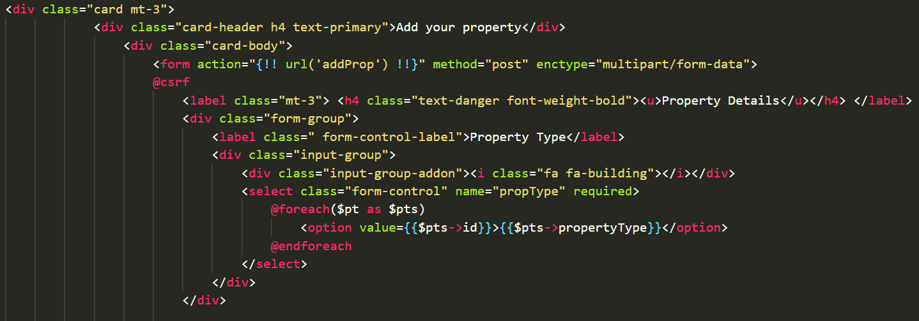
Coding - View

Slide 35
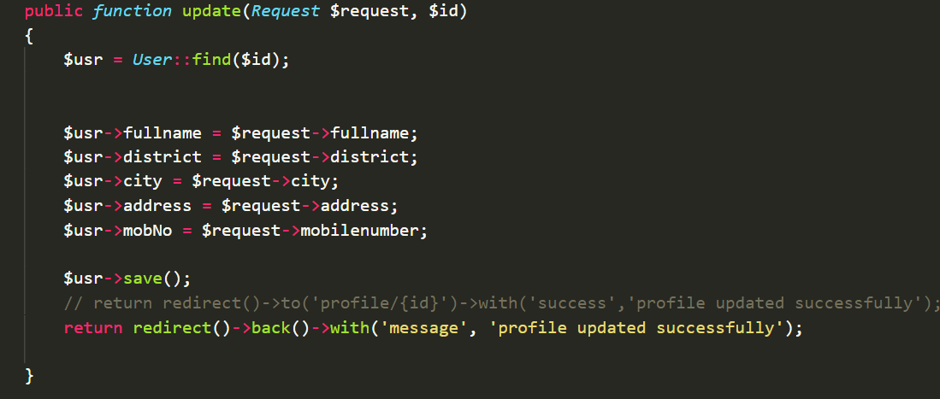
Coding - Controller

Slide 36
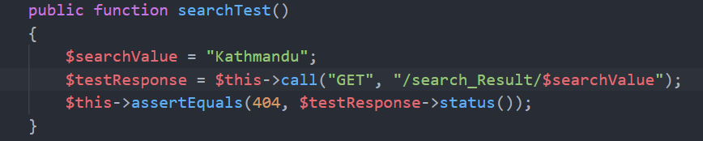
Testing
Only few testing are shown here

Slide 37
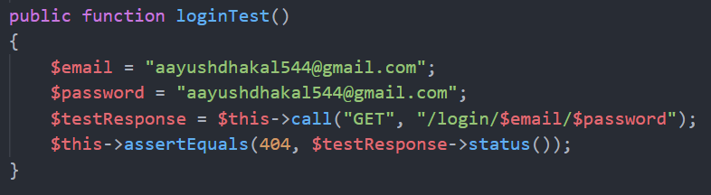

Slide 38
Limitation
Lack of strong verification process
Lacks Realtime communication facilities

Slide 39
Future work
Improvement in design using UI/UX
Realtime chat system between owner and buyer
Online payment system
Technical supporting (in case of any difficulty)
Strong security mechanism

Slide 40
User Manual

Slide 41
Conclusion
I successfully completed my project that performs intended work I have mentioned in my proposal

Slide 42
References
Rouse, M. (2019, 1 5). Tech Target. Retrieved from Tech Target: https://searchitoperations.techtarget.com/definition/configuration-management-CM

